Slide 1
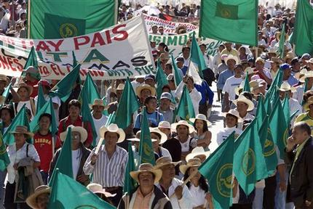
Convergence in Diversity
Food Movements & the Transformation of our Food Systems
Eric Holt-Giménez
Food First

Slide 2

Food Crisis
“Riots” or Rebellions?
2008: Mexico, Italy, Morocco, Mauritania, Senegal, Indonesia, Burkina Faso, Cameroon, Yemen, Egypt, Haiti (40+)
Not lack of food, but high prices
2011: Algeria, Tunisia, Yemen, Egypt
high prices + poverty + entitlement gap + lack of democracy

Slide 3
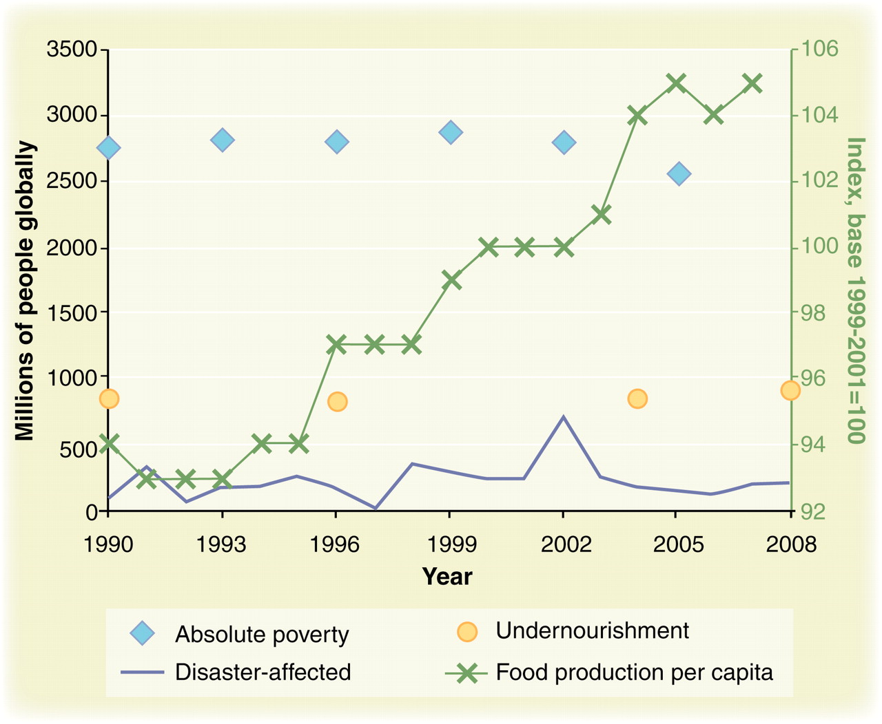

“The undernourished population has increased by 9% globally despite a 12% rise in global food production per capita since 1990.”
C B Barrett Science 2010;327:825-828
Published by AAAS
Notes:
Different food security proxy indicators paint different pictures. Undernourishment is far greater than just those affected by disasters but much less than those living in absolute poverty. And none of those measures show the improvement over time that food availability measures do. Data sources: Absolute poverty (<$2/person per day): (31); Undernourishment: (32); Disaster-affected populations: (33). Gross food production per capita (base 1999–2001 = 100) (34). Food production series to be read against right-hand vertical axis; all other series against left-hand vertical axis. Unfortunately, no comparable series are available for micronutrient malnutrition or for perceptions-based measures.

Slide 4
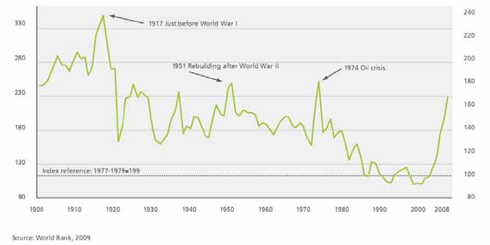
Food Price Spikes
Food Price Index Spikes

Slide 5
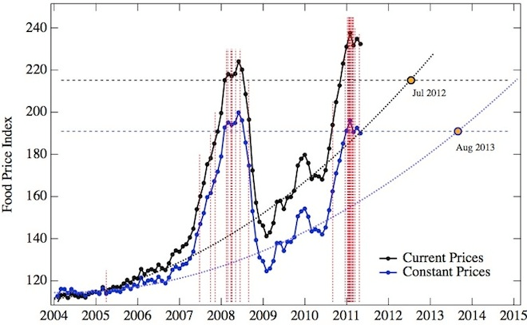
FAO Price Index at current prices (black curve) and corrected for inflation (blue curve) between January 2004 and May 2011. Red dashed lines signify the beginning dates of food riots and unrest in North Africa and the Middle East. Black and blue horizontal lines represent the current-price and inflation-adjusted food price thresholds for riots. “The Food Crises and Political Instability in North Africa and the Middle East.” By Marco Lagi, Karla Z. Bertrand and Yaneer Bar-Yam. arXiv, Aug. 11, 2011.

Slide 6
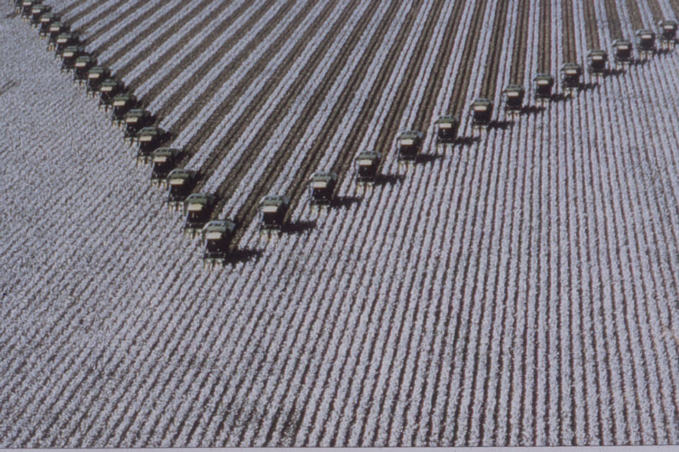
Record Harvests
Record Hunger
Record Profits
Bumper harvests: 2007-08 +5%; highest corn crop in history
1 billion people hungry
Bumper profits last quarter: ADM 20%; Monsanto 45%, Cargill 86%; General Foods 61%

Slide 7
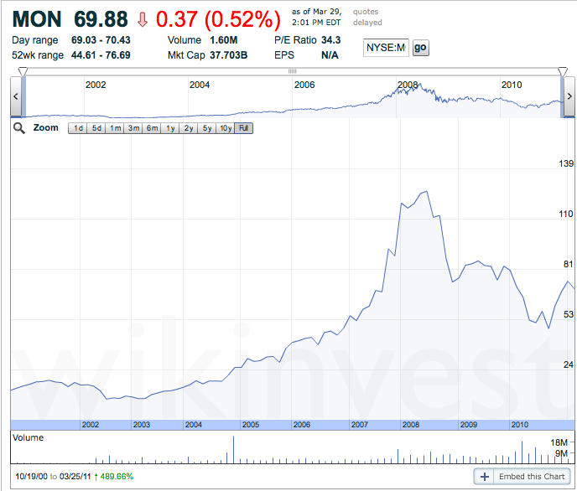
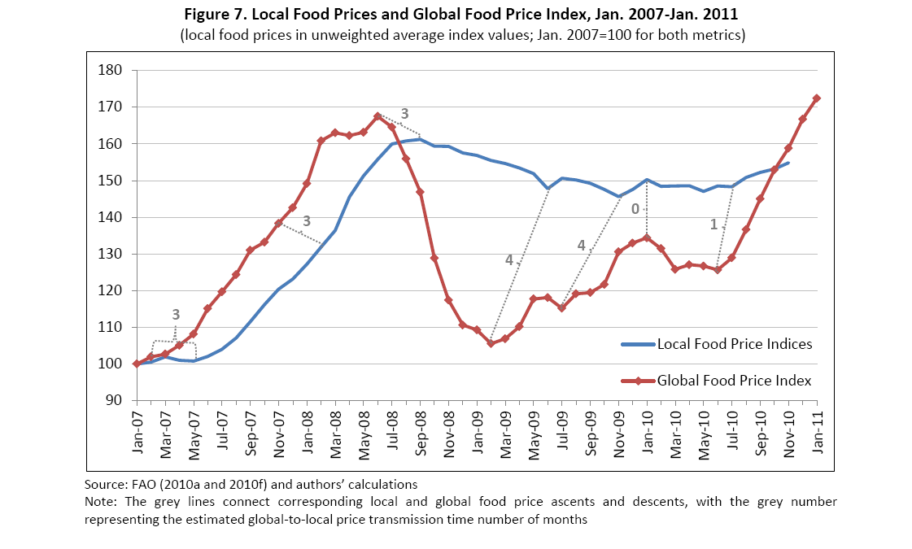

1 billion hungry
840 million hungry
1 billion hungry
1 Billion
hungry
950 million
hungry
Notes:
Biggest problem is that GMOs are a key technology for monopoly-based strategies for northern economic/recovery
overcome saturated northern markets & declining sales
Shift from heavy industry and manufacture to proprietary genetic technologies
Agrifoods monopolies increases in profits track with increase in numbers of hungry and malnourished people

Slide 8
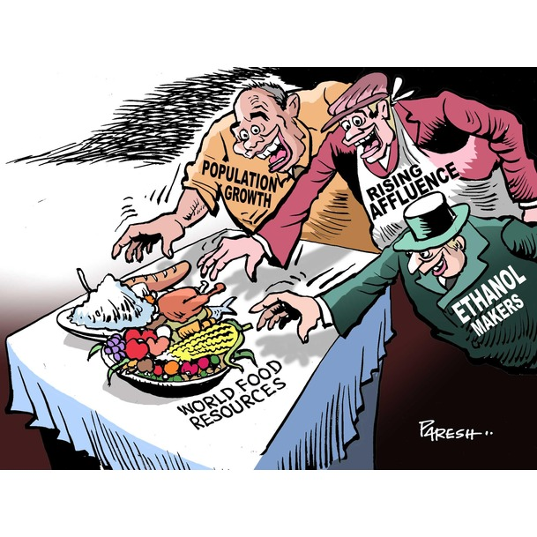
Proximate causes
Climate; droughts
Rising meat consumption India, China, Brazil
5% fall in cereal production 2005-06 (Low-Income Food-Deficient Countries) will go up only 11% in 2011)
Low grain reserves (19—23% stocks-to-use)
Higher oil prices: 2X transport
3X fertilizer costs
½ world grain for industrial uses
(40% US corn crop to agrofuels)
Weak dollar
Financial Speculation; CIFs
CIFs=$13bn (2003)
to $317bn (2008)
$60bn in 2010 alone

Slide 9

Root Causes
Vulnerable food system:
  91% cropland cotton, maize, wheat, rice & soy
  Economic shock
  Environmental shock
Industrial Agri-foods Complex
  Grain traders/processors
  Seed & genetic engineering
  Retail & distributors

Slide 10

Rise of the
Corporate Food Regime
Green Revolution 1960-80s
Structural Adjustment Policies 80s-90s
  removal tariff barriers
  dismantling of marketing boards
  non-food export crops
  Dismantling of reserves
Free Trade “mania” 1990s-present
  WTO, FTAs (NAFTA, CAFTA)
  Subsidies, Surplus, Dumping

Slide 11

Results?
Global South Food 1970-2001 :
$ 1 billion surplus—$ 11 billion deficit
Industrial Agriculture: 20% GHG; 80% water
Loss of 75% crop diversity
Increase food per capita = increase hungry = 11%
Cost of 20 years Trade liberalization sub-Saharan Africa = US$272 billion = amount that the region received in aid
Immigration: 1.3 million Mexican smallholders bankrupt (1994-2004) 1 million immigrants to the U.S.
GR: $10.2 billion/yr U.S. corn and soy production
ADM, Cargill, Bunge 80% grain; Monsanto 1/5 seeds

Slide 12
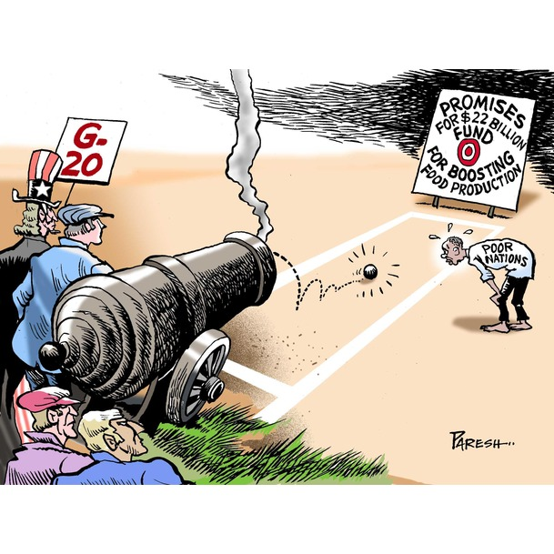
G-20
(L’Aquila, 2009; Paris, June 2011)
Less than 1/20

Slide 13
Combating Hunger?
  Feed the Future/Global Food Security Act
  Global Harvest Initiative
  Alliance for a Green Revolution in Africa
  G-20 promises/agreements (GAFSP, HLTF, CFA )
  Increase production (70% by 2050)
    Industrialization of agriculture (agrarian transition)
    GMO-led Green Revolution (WEMA)
    New focus on smallholders (land mobility)
  Market-led, aid-backed
    WTO Doha Round , FTAs, REDD
    Public-private partnerships
    Globalization of land, input markets

Slide 14
“The way the world grows its food will have to change radically to better serve the poor and hungry if the world is to cope with growing population and climate change while avoiding social breakdown and environmental collapse.”
FAO, GEF, UNDP, UNEP, UNESCO, World Bank and WHO
Notes:
14

Slide 15
What did experts find?
GMOs not needed
  Do not raise intrinsic yields
  Unable to fully address climate resilience
  (IAASTD, USDA, Union of Concerned Scientists)
Free Trade Agreements detrimental
  90% benefits go to Northern countries
  Benefits to poor farmers $2/year/farmer
  (World Bank)
Agroecology & local food system economies the way forward
  (IAASTD)

Slide 16
From “land mobility” to “surplus people”
2.5 billion Smallholder livelihoods versus Capital’s crises of accumulation
Land grabs/Concentration (50 million farms?)
  Agrofuels/feedlots/grains
  Speculation/hedging
  GMOs/Corporate control over food supply
Unregulated global market
  Export surges & dumping… export bans
Loss of resilience
  agro-biodiversity, topsoil, water
  Climate change

Slide 17
The Corporate Food Regime
A food regime is a “rule-governed structure of production and consumption of food on a world scale” (Friedman 1993).
The corporate food regime, based on fossil fuels; dominated by global monopolies; characterized, inter alia, by the “supermarket revolution,” global animal protein chains, and GMOs (McMichael 2009).
Monopolies, World Bank/IMF, World Food Program, USAID, and big philanthropy.

Slide 18
Food Regime Management
Liberalization period characterized by unregulated markets and breathtaking capital expansion, followed by devastating busts.
Reformist period in which markets, supply, and consumption are regulated in an effort to re-stabilize the regime.
While these phases may appear politically distinct, they are actually two sides of the same system.
(Polanyi 1944)

Slide 19
Counter-Movement to the CFR
Right to food: A human right of all human beings to live in dignity, free from hunger, food insecurity and malnutrition. The right to food is not about charity, but about ensuring that all people have the capacity to feed themselves in dignity.
Food justice: Fair distribution of benefits & risks of production, transport, distribution, access and consumption, without disparities or inequities.
Food Sovereignty: People’s right to healthy and culturally appropriate food produced through ecologically sound and sustainable methods, and their right to define their own food and agriculture systems.

Slide 20
Politics, Production Models & Approaches
 | Corporate Food Regime |  | Food Movements
POLITICS | NEOLIBERAL | REFORMIST | PROGRESSIVE | RADICAL
Discourse Main Institutions Orientation | Food Enterprise International Finance Corporation (World Bank); IMF, WTO: USDA; Global Food Security Bill; Green Revolution; Millennium Challenge; Heritage Foundation; Chicago Global Council, Bill and Melinda Gates Foundation; Corporate | Food Security International Bank for Reconstruction and Development (World Bank); FAO; U.N. Commission on Sustainable Development; International Federation of Agricultural Producers; mainstream Fair Trade; Slow Food; some Food Policy Councils; most food banks and food aid programs. Development | Food Justice Alternative Fair Trade & many Slow Foods chapters, many organizations in the Community Food Security Movement; CSAs; many Food Policy Councils & Youth food and justice movements; many farmworker & labor organizations ,\; UN CFS Empowerment | Food Sovereignty Via Campesina, International Planning Committee on Food Sovereignty; Global March for Women; many Food Justice and rights-based movements , UN Committee on Food Security CSO Committee , many farmer organizations w/in federations (PELUM, ROPPA, ESAFF, ) African, US, EU Food Sovereignty Alliances Entitlement
MODEL | Overproduction; Corporate concentration; Unregulated markets and monopolies; Monocultures (including organic); GMOs; Agrofuels; mass global consumption of industrial food; phasing out of peasant & family agriculture and local retail. | Mainstreaming/ certification of niche markets (e.g. organic, fair, local, sustainable) and plantation agriculture; maintaining northern agricultural subsidies; “sustainable” roundtables for agrofuels, soy, forest product, etc; market-led land reform | Agroecologically-produced local food; investment in underserved communities; new business models and community benefit packages for production, processing & retail; better wages for ag. workers; solidarity economies; land access; regulated markets & supply | Democratization of food system; Dismantle corporate agri-foods monopoly power; parity; redistributive land reform; community rights to water & seed; Regionally-based food systems; sustainable livelihoods; ; protection from dumping/ overproduction; Revival of agroecologically-managed peasant agriculture to distribute wealth and cool the planet
Approach to the Food Crisis Guiding document | Increased industrial production; unregulated corporate monopolies; land grabs; expansion of GMOs; public-private partnerships; Liberal markets; Int’l. sourced food aid; WB 2009 Dev. Report | Same as Neo-liberal but w/increased middle peasant production & some locally-sourced food aid; more agricultural aid, but tied to GMOs & “bio-fortified/climate-resistant” crops. WB 2009 Dev. Report | Right to food; Better safety nets; sustainably-produced, locally-sourced food; agroecologically-based agricultural development; guiding document: IAASTD | Human right to food sovereignty; Locally sourced, sustainably produced, culturally appropriate, democratically controlled focus on UN/FAO negotiations Peoples’ comprehensive framework for action; UN Right to Food series; IAASTD; Food Movements Unite

Slide 21
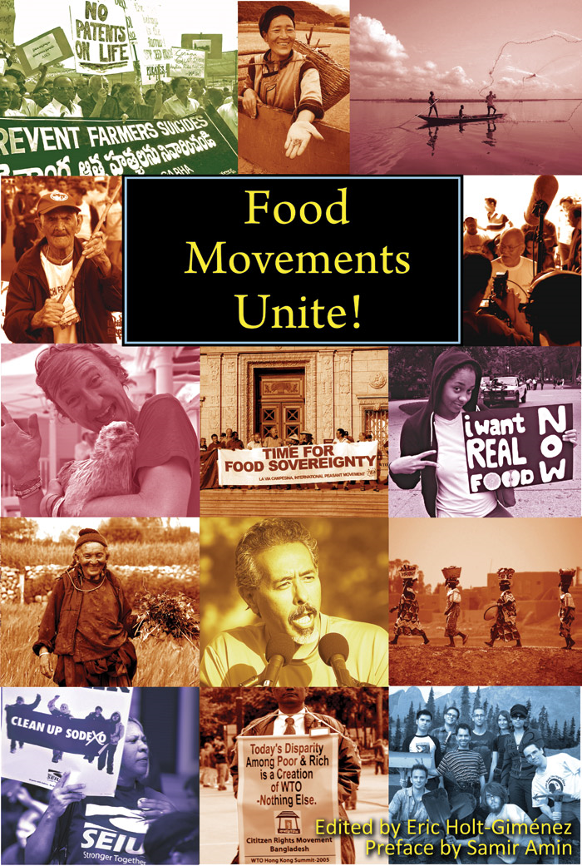
First Wave
Second Wave
Repoliticization & Convergence in Diversity

