Slide 1
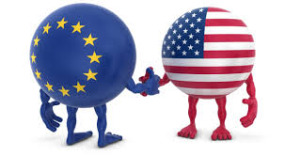
Transatlantic Trade and Investment Partnership
Roeline Knottnerus
Stichting Onderzoek Multinationale Ondernemingen (SOMO)
Transnational Institute (TNI)

Slide 2
TTIP
Trans-Atlantic Trade and Investment Agreement
Negotiations started in July 2013
Aimed at bringing down non-trade barriers and liberalisation of goods, services, investment and public procurement
Limits public policy space
Poses threat to public budgets
Dubious economic benefits

Slide 3
Non-tariff measures involve standards and labelling requirements for different products and are put in place to protect public health as well as the environment.
Non-tariff measures such as regulations, taxes and subsidies, are employed by the Government to increase national welfare and achieve public policy objectives.
Many non-tariff measures may restrict trade but can improve welfare in the presence of negative externalities

Slide 4
Disturbing business bias
Watchdog Corporate Europe Observatory found out:
93% of the Commission’s meetings with stakeholders during the preparations of the EU-US free trade talks were with big business
The most frequent guests at DG Trade included:
BusinessEurope
US Chamber of Commerce,
European Services Forum
Transatlantic Business Council
There were also numerous meetings with the arms industry, banking, medical technology, food, pharma and chemical lobbies.

Slide 5
THEORY UNDERLYING EXPECTATIONS OF ARBITRATOR BIAS
investment treaty arbitration does not incorporate the usual institutional safeguards of judicial independence
no judicial security of tenure
no prohibitions on outside remuneration by the judge
no objective method of appointment to specific cases
no open court principle
investment treaty arbitration is uniquely asymmetrical and insulated from judicial review
founds perceptions of arbitrator dependence on prospective claimants, default appointing authorities, gatekeepers in the arbitration industry, and treaty rule-makers

Slide 6
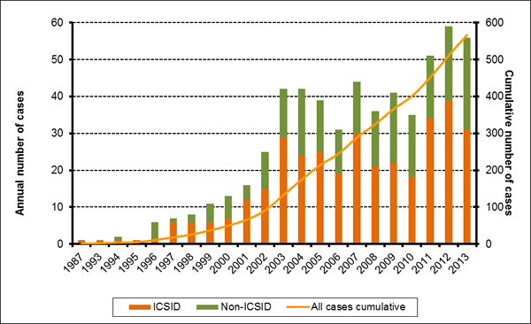
Total investor-state cases reached 568 in 2013

Slide 7
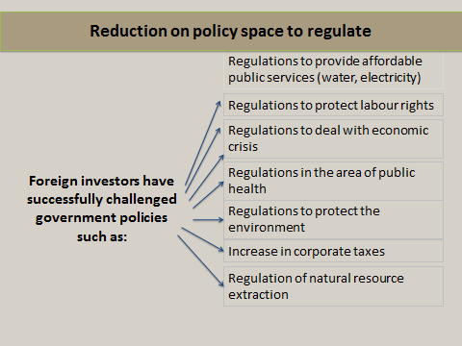

Slide 8
ISDS - cases
Corporations versus public health
Philip Morris v. Uruguay and Australia
Achmea v. the Slovak Republic
Corporations versus nuclear energy
- Vattenfall v. Germany
Corporations versus labour rights
- Veolia v. Egypt
Corporations versus environmental protection
- Lone Pine v. Canada
Corporations versus crisis measures/debt restructuring
Ping An vs Belgium
Poštová bank and Istrokapital vs Greece
Notes:
Corporations versus public health – Philip Morris v. Uruguay and Australia:
On the basis of bilateral investment treaties, US tobacco giant Philip Morris is
suing both Uruguay and Australia over their anti-smoking laws. The company
argues that warning labels on cigarette packs prevent it from effectively
displaying its trademarks, causing a substantial loss of market share.
Achmea v, the Slovak Republic: At the end of 2012, Dutch insurer Achmea (formerly Eureko) was awarded €22 million in compensation from Slovakia. In 2006, the Slovak government had reversed the health privatisation policies of the previous administration and required health insurers to operate on a not-for-profit basis.
Corporations versus nuclear energy – Vattenfall v. Germany:
In 2012 Swedish energy multinational Vattenfall sued the German government,
seeking €3.7 billion in compensation for lost profits related to two of its
nuclear power plants. The lawsuit followed the German government’s
decision to phase out nuclear energy after the Fukushima nuclear disaster.
Corporations v. labour rights – Veolia v. Egypt:
Corporate attack on Egypt’s minimum wage increase. Volia, in total disregard of workers’ rights, is in fact arguing for abolition of Egypt’s minimum wage.
One of the major lawsuits against Egypt after the revolution was the one by the French-based multinational Veolia. One of its several claims maintained that applying a minimum wage in the country would hurt Veolia’s investments and represent a violation of Egypt’s commitments in its bilateral investment treaty with France. The case shows how BITs can seriously hinder a country’s ability to review any of its legislations or its capacity to develop its domestic policies.
Corporations versus environmental protection – Lone Pine v. Canada:
On the basis of the North American Free Trade Agreement (NAFTA)
between the US, Canada and Mexico, US company Lone Pine Resources Inc.
is demanding €191 million in compensation from Canada. The Canadian
province of Quebec had put a moratorium on ‘fracking’, addressing
concerns about the considerable environmental risks of this new technology
to extract gas or oil from rocks.

Slide 9
Damages in investment cases
Occidental Petroleum Corporation v the Republic of Ecuador – damages of US$1.77 billion (US$2.3 billion with interest applied) = largest award ever
Swedish energy company Vattenfall is claiming €4.7 billion for lost profits following the German government’s decision to phase out nuclear energy

Slide 10
Investment awards in perspective
Germany
GDP: €2,476.8 billion
Government budget: €1,164.1 billion (46.6 percent of GDP)
Annual deficit: €106.5 billion (4.3 percent of GDP) [Eurostat – 2010 figures]
Vattenfall’s claim of €4.7 billion equals roughly 4.5% (!) of the annual budget deficit of Germany.

Slide 11
Even legal costs are inhibiting
Legal and arbitration costs average over US$8 million, exceeding US$30 million in some cases (source: OECD)
Costs in perspective: The Philippines government spent US$58 million to defend two cases against German airport operator Fraport – the equivalent of the salaries of 12,500 teachers for 1 year, vaccination for 3.8 million children against diseases such as TB, diphtheria, tetanus, polio; or the building of 2 new airports.

Slide 12
Investment claims bring risk of ‘regulatory chill’ – side-lining of necessary or politically opportune measures because of the potential extra costs attached to them

Slide 13
“I’ve seen the letters from the New York and DC law firms coming up to the Canadian government on virtually every new environmental regulation […]. Virtually all of the new initiatives were targeted and most of them never saw the light of day.”
Former Canadian government official

Slide 14
“When I wake up at night and think about arbitration, it never ceases to amaze me that sovereign states have agreed to investment arbitration at all […] Three private individuals are entrusted with the power to review, without any restriction or appeal procedure, all actions of the government, all decisions of the courts, and all laws and regulations emanating from parliament.“
Juan Fernández-Armesto
Arbitrator from Spain

Slide 15
TTIP
Argumenten voor
Argumenten voor?
Volgens de Europese Commisie kan (op termijn) TTIP een economische impuls betekenen van €120 mrd voor de EU en van €90 mrd voor de VS;
Voor NL €1,4 – €4,1 mrd;
Kan leiden tot 100.000-en extra banen in EU;
Verlengt/versterkt Westerse dominantie in standaarden.
Kan in beste geval leiden tot 0,5% extra bbp in 2027, als TTIP alle handelsbelemmeringen slecht;
Onderzoek (van EC) acht dit niet waarschijnlijk, positief economisch effect onzeker;
Voor NL: eerder 0,2%, dan 0,6%
Kost ook veel banen (zie NAFTA), in elk geval langdurige en pijnlijke aanpassing;
Ondermijnt juist standaarden.

Slide 16
Jeronim Capaldo The Trans-Atlantic Trade and Investment Partnership: European Disintegration, Unemployment and Instability Tufts University, October 2013 http://ase.tufts.edu/gdae/policy_research/TTIP_simulations.html

Slide 17
Capaldo: independent research based on UN Global Policy Model.
Main findings
Substitution of intra-EU trade with Trans-Atlantic trade will lead to disintegration in the EU
Net losses of exports of up to 2% GDP
GDP losses, particularly in Northern Europe
Loss of 3-5,000 euros income per worker
Loss of approx. 600,000 jobs in EU
Reduction of labour share of GDP
Loss of government revenues
Increased macroeconomic instability

Slide 18
Concerns over ISDS are resonating with policy-makers
Yesterday, the Dutch Parliament adopted a motion calling on the Dutch governments to reject ISDS in the trade agreements with Canada (CETA) and the US (TTIP) because of the inherent social, financial and environmental risks
But trade minister Ploumen continues to maintain that the benefits of TTIP outweigh the risks.

Slide 19
Further reading
Profiting from Crisis: How corporations and lawyers are scavenging profits from Europe’s crisis countries
www.tni.org/profiting-crisis
Profiting from injustice: How law firms, arbitrators and financiers are fuelling an investment arbitration boom
http://www.tni.org/briefing/profiting-injustice

Slide 20
Take action
We call on the institutions of the European Union and its member states to stop the negotiations with the USA on the Transatlantic Trade and Investment Partnership (TTIP) and not to ratify the Comprehensive Economic and Trade Agreement (CETA) with Canada.
Main objectives:
We want to prevent TTIP and CETA because they include several critical issues such as investor-state dispute settlement and rules on regulatory cooperation that pose a threat to democracy and the rule of law. We want to prevent lowering of standards concerning employment, social, environmental, privacy and consumers and the deregulation of public services (such as water) and cultural assets from being deregulated in non-transparent negotiations. The ECI supports an alternative trade and investment policy in the EU.
Support the self-organised Stop-TTIP European Citizens’ Initiative
Sign now at:
https://stop-ttip.org/sign/

